Slide 1

WHITEPAPER
DEJAVE
Version 1.1
http://www.dejave.io

Slide 2
NATURE
POWER COMMUNITY
DEJAVE
SELL
SPECIFICATION
BUY
SELL
Name Token
DEJAVE
Ticker
DJV
Decimals
6
BUY
Max Supply
30,000 DJV
Blockchain
TRC20 (Tron Blockchain)
Contract Token Address
TQDRp2VCRc3s9X1zx2CgLoauPp44iQVaw8

Slide 3

DEJAVE ALLOCATION
DeFI Allocation
DeFI Allocation : 15,000 (6 Years)
2024
2023
(20% APY) Allocation 3,000 DJV
2022
(25% APY) Allocation 3,000 DJV
2021
(30% APY) Allocation 3,000 DJV
2020
(35% APY) Allocation 3,000 DJV
(40% APY) Allocation 1,000 DJV
2020
2021
2022
2023
2024

Slide 4

ROADMAP
2
Q3 2020
Q4 2020
Website Building, Presale and Development DeFI Platform
1
Presale, Listing on CMC and Coingecko, Listing on CCTip, Listing On Several Exchanger
4
Q1 2021
Q2 2021
Release on Big Exchange, Increase Community, Development Various DeFI Platform, Marketing Online and Airdrop and Bounty Challenge
3
Release DeFI Project Platform, Community Voting on Big Exchanger, Airdrop and Bounty Challenge
6
Q3 2021
Q4 2021
5
Development Payment System and Using DJV for Utility
Mainnet DEJAVE Token to Own Blockchain

Slide 5

TOKEN ALLOCATION
1. | Presale | 1000 | DJV | 3,33%
2. | Marketing | 2000 | DJV | 6,67%
3. | DeFi Platform | 10000 | DJV | 33,33%
4. | Development | 2850 | DJV | 9,50%
5. | Airdrop & Bounty | 150 | DJV | 0,50%
6. | Team and Founder | 2000 | DJV | 6,67%
7. | Investor (3 Years) | 10000 | DJV | 33,33%
8. | Investor ROI 5% p.a | 1500 | DJV | 5,00%
9. | Social Grant | 500 | DJV | 1,67%
WALLET TOKEN
Presale
Marketing
DeFi Platform
Development
Airdrop & Bounty
Team and Founder
Investor (3years)
Investor ROI 5% p.a
Social Grant

Slide 6
TOKEN FUND ALLOCATION
Liquidity (15%)
Development (15%)
Marketing (20%)
Reserving Fund (50%)

Slide 7
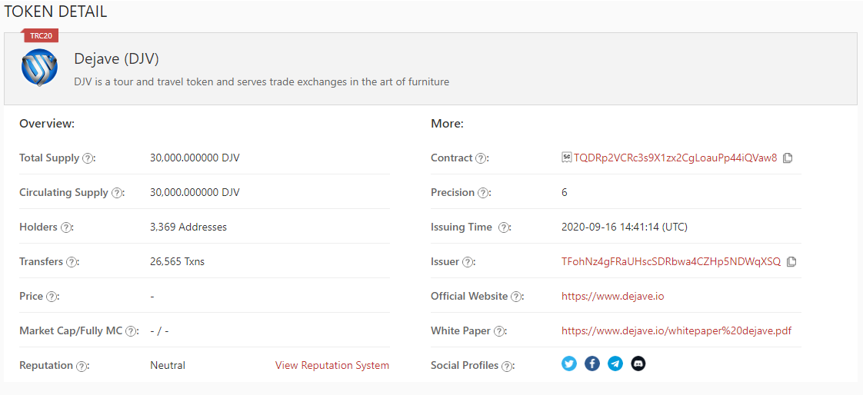
justswap.io
https://justswap.org/?lang=en-US#/scan/detail/trx/TQDRp2VCRc3s9X1zx2CgLoauPp44iQVaw8
cctip.io
https://my.cctip.io/token/swap/pair/06060001-06090060

Slide 8

DJV TOKEN
Here we are now !
Ecosystem Network
Upcoming Development
System Integration
Upcoming Development
Support System
Upcoming Development
Mission
Our Mission is to create a unique one stop solution in social network and payment platform, make it universally accessible ecosystem.
Vision
Our Vision is to create future accessible social platform as network for promotion of new coins or tokens through innovative technology and products.

Slide 9

Thank You
DEJAVE (NATURE POWER COMMUNITY)

